Slide 1
P04 Getting it Straight 6th Presentation
A113 – Mathematics

Slide 2
Visual Examination
Whilst engaging in the StraightLine.xls, you would have realised that visual examination does have a limitation in that we cannot be 100% sure if the line passes through the centre of the dots.
Hence to accomplish one of the objectives of the game (testing collinearity), which we had played on the Game platform, we had to make use of algebraic methods, such as finding the gradients of lines to ensure that the points are indeed collinear.

Slide 3
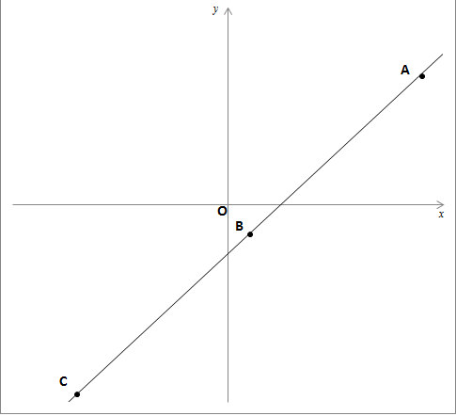
Limitations of visual examination
y
In Sheet1 of StraightLine.xls, when a straight line is drawn across dots A, B and C, it is visually not very obvious whether the centre of dot A lies exactly on the straight line.
Visual examination is also a handicap when we are playing the game using other platforms.
Not obvious

Slide 4

Gradient of a straight line
Given 2 points on a straight line, (x₁, y₁) and (x₂, y₂), the gradient is .
y
If a straight line is slanting upward from left to right, then the gradient of this line is a positive value.
If a straight line is slanting downward from left to right, then the gradient of this line is a negative value.
x
Positive gradient
y
x
Negative gradient

Slide 5
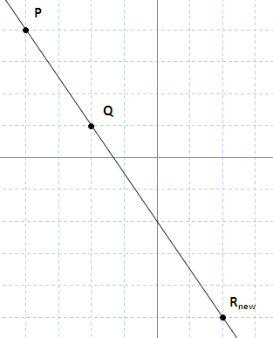
Collinearity
y
In Sheet3 of StraightLine.xls, the ratio of the vertical distance to the horizontal distance of point P and Q is the same as that of point Q and R_{new}.
Since the two ratios are equal and Q is a common point, this shows that P, Q and R_{new} are collinear.
PQ:
3
The two ratios are equal.
2
0
x
QRnew:
6
4

Slide 6
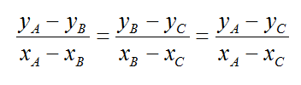
Collinearity
A (x_{A}, y_{A})
B (x_{B}, y_{B})
C (x_{C}, y_{C})
If 3 points A (x_{A}, y_{A}), B (x_{B}, y_{B}), C (x_{C}, y_{C}) are collinear, then Gradient of AB = Gradient of BC = Gradient of AC.

Slide 7
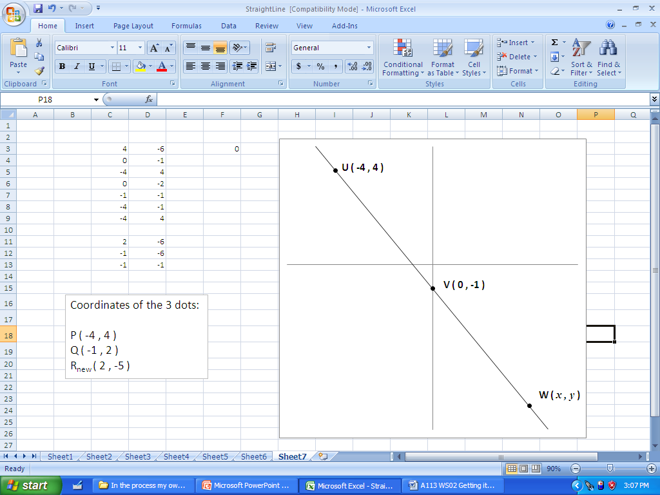
Straight line equation
y
If the gridlines are not given, we can also use the difference of the coordinates of the points to find the vertical and horizontal distances between the points.
The example shown here are 3 collinear dots. The coordinates of W are given as (x , y).
We may use the approach discussed earlier to find the possible values of x and y.
0
x

Slide 8
Straight line equation
y
Since U, V and W are collinear,
Gradient of UV = Gradient of VW
We can simplify the equation to the form where y is expressed in terms of x
4 – (–1)
= 5
0
x
– 4 – 0
= – 4
– 1 – y
0 – x

Slide 9
Straight line equation
Gradient
y
The equation
is the straight line equation.
The coordinates of any points that lie on this line satisfy this equation.
The coefficient of the variable, x, (for this case, –1.25) is the gradient of the line.
The value, -1, which is the y-value when x = 0, is called the y-intercept.
Similarly, the x-value when y = 0, is called the x-intercept.
y-intercept
x-intercept
y-intercept
0
x

Slide 10
x-intercept and y-intercept
Using the straight line equation:
The x-intercept can be calculated when we substitute y = 0
The y-intercept can be calculated when we substitute x = 0

Slide 11
Straight line equation
In general, an equation in the form
where m and c are constants, is a straight line equation.
The value m is the gradient of the straight line. It measures the steepness of the line with respect to the x-axis.
The point (0, c) is the coordinates of the y-intercept. It is where the straight line intersects the y-axis.

Slide 12
Parallel lines and perpendicular lines
Two straight lines parallel to each other will have the same gradient.
If two straight lines are perpendicular to one another, then the product of their gradients will be equal to –1.
Same gradient
Gradient = m₁
Gradient = m₂
m₁ × m₂ = –1

Slide 13
Worked Example (Practice Question Q8)
Question:
Given that a straight line has equation: . What are the gradient and the y-intercept of this line?
Solution:
Comparing the equation with
We will obtain the gradient of this line and the y-intercept as
gradient, and
y-intercept,

Slide 14
Worked Example (Practice Questions Q9)
Question:
Calculate the value of k if the point (k, 2k) lies on the straight line .
Solution:
As the point (k, 2k) lies on the straight line, it would satisfy the equation, .
We have

Slide 15
Worked Example (Practice Questions Q12)
Question:
If straight line PQ is perpendicular to straight line RS and the gradient of PQ is 2, what is the gradient of RS?
Solution:
Since line PQ is perpendicular to line RS, the product of their gradients would be -1. We have

Slide 16
Learning Objectives
Determine the gradient and intercepts of a linear equation from the graph or the equation.
Demonstrate an understanding of the relationship for two lines to be parallel/perpendicular.
Apply the concept of linear equation using algebraic and graphical methods to find solution to problems.

Slide 17
Exploring Further - Determine relationship between two variables
In many real-life situations, we need to determine the relationship between two variables, e.g. the heights and the weights of students. This relationship would help to describe the variables as well as to make prediction.
Before we could work out the relationship between two variables, we have to collect data on the two variables through experiments or surveys.

Slide 18
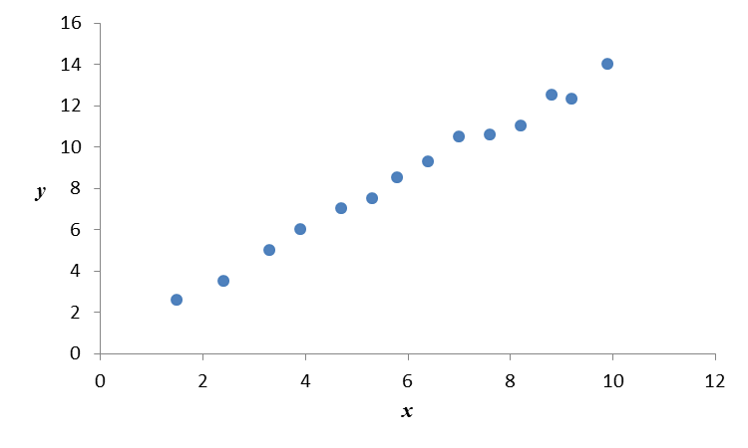
Exploring Further - Linear Regression
After looking at the collected data, if we believe that there is a linear relationship between the two variables, we can derive the linear regression equation by selecting the best fitting line,
where is the predicted value using the equation.

Slide 19
Exploring Further - Linear Regression
The best fitting line is the line for which the sum of squared differences between the actual and predicted values, i.e. is a minimum.
This is known as the least squares method.

